Slide 1
Evaluation Type
22/07/2019
Simone Ferrari (simone.ferrari@polito.it)

Slide 2
Introduction
This document illustrates the type of FEA simulations available in post-processing window

Slide 3
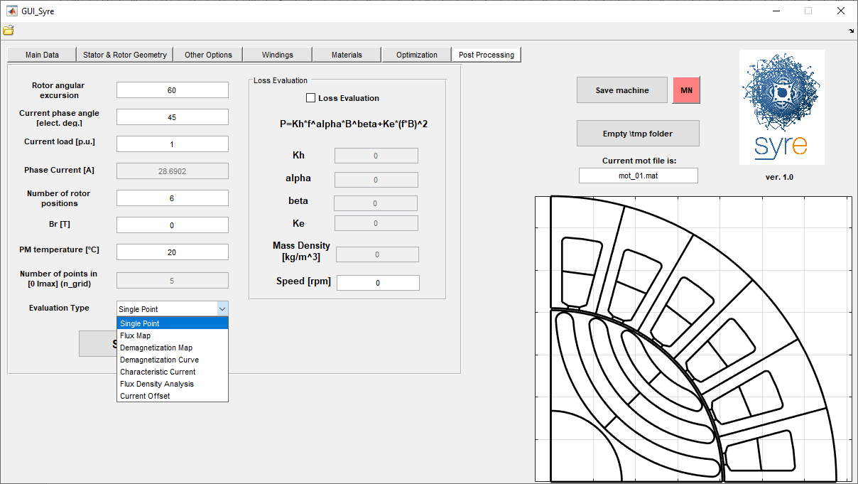
Evaluation type
The Evaluation type is set with a pop-up window in post-processing tab. The types available are:
Single point
Flux map
Demagnetization Map
Demagnetization Curve
Characteristic current
Flux Density Analysis
Current Offset

Slide 4
Single Point
This is the standard simulation. It is possible to set:
Current amplitude
Current angle
PM remanence (if present)
And FEA-compute flux linkages and torque.
If vectors are used to define current, a sensitivity analysis is performed (in parallel, if pool enabled)

Slide 5
Flux Map
It allows to perform flux maps, so flux linkages, torque and torque ripple over the dq-plane.
It always work with parallel computing, if lincenced.

Slide 6
Demangetization Map
It perform a map in the current-temperature plane, in order to detect the critical points for the demagnetization.
The considered current vector is computed as linspace(0,Imax,Ngrid) and the temperature vector is added in temperature tab

Slide 7
Demagnetization Curve
It evaluate the demagnetization current function of temperature. The temperature vector is defined in the proper tab, while current is iteratively computer for each temperatures

Slide 8
Flux Density Analysis
It perform a standard simulation, with the extra information of:
Airgap flux density along the rotor for each rotor position
Tooth flux density, sampled along the arc that cross the middle tooth
Stator yoke flux density, sampled in the middle of the stator yoke

Slide 9
Current offset
It perform a standard simulation with a common mode current of 20% of the input current

